Slide 1
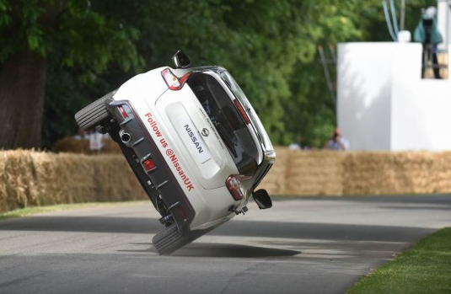
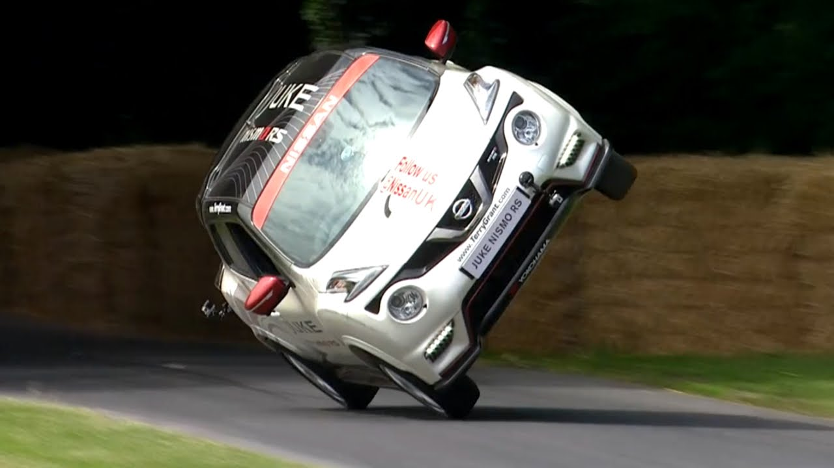
Centre of Mass, Stability and Equilibrium

Slide 2
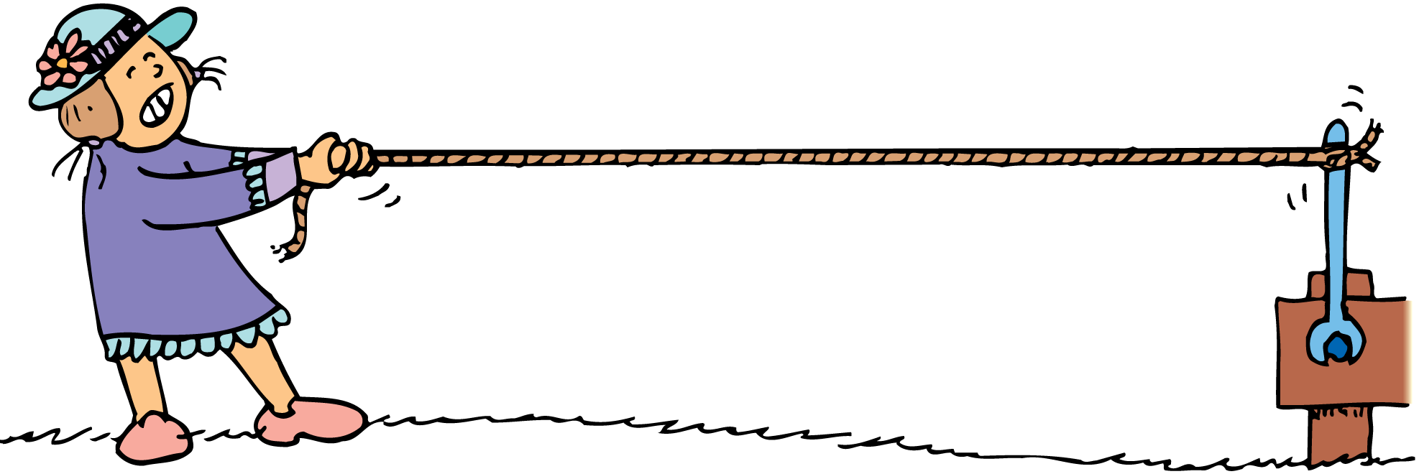
Lesson Review Torque
think!
If you cannot exert enough torque to turn a stubborn bolt, would more torque be produced if you fastened a length of rope to the wrench handle as shown?

Slide 3
Lesson Review Torque
think!
If you cannot exert enough torque to turn a stubborn bolt, would more torque be produced if you fastened a length of rope to the wrench handle as shown?
Answer:
No, because the lever arm is the same length. The line of force has been extended but not the perpendicular radius. To increase the lever arm, a better idea would be to use a pipe that extends upward

Slide 4

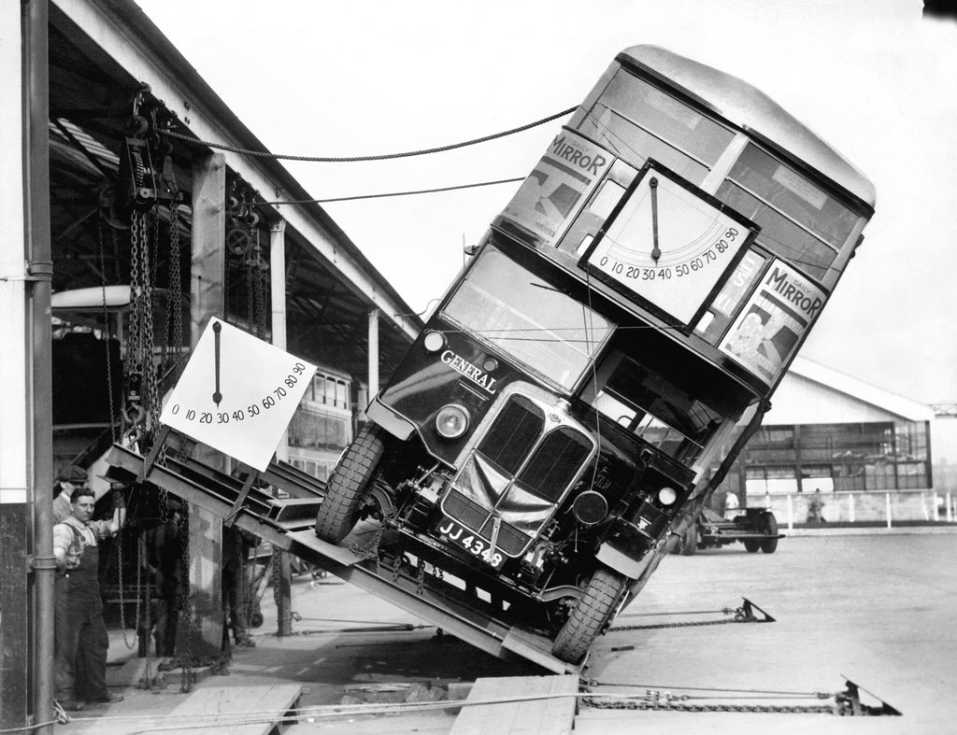
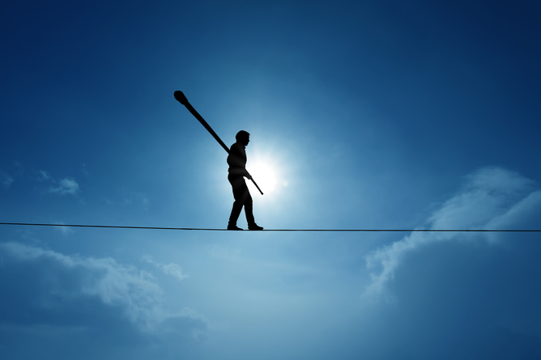
Today’s lesson
Understand what is meant by the term “Centre of Gravity/Mass”.
Know that the stability of an object is related to the location of it’s centre of mass as well as the size of its base.

Slide 5
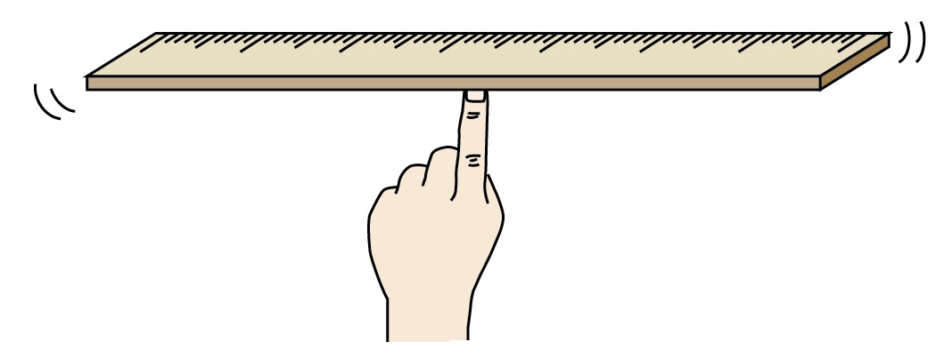
Centre of Mass and Gravity
The centre of mass or gravity of a body is the point through which its weight appears to act.
If you attempt to balance a metre rule with your index finger, where would you expect to have to put your finger?

Slide 6
Centre of Mass and Gravity
Why does a uniform metre rule balance only at the 50 cm mark?
If you attempt to balance it any where else, its weight would produce a torque about your finger.
W
W
When the pivot is not at the 50 cm mark, the moment of the weight W is not zero. This causes the ruler to turn clockwise about the pivot.
When the pivot is at the 50 cm mark, the ruler is balanced. The moment of the weight is zero. Why?

Slide 7
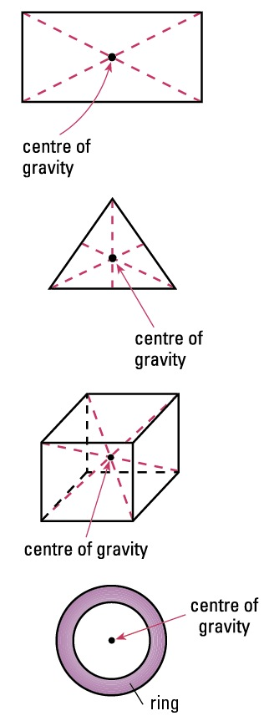
Centre of Mass and Gravity
For uniform or regular objects, the Centre of Gravity is at the centre of the object.
Centre of gravity of regular-shaped objects.

Slide 8
Centre of Mass and Gravity
What about irregularly shaped objects?
So, if you hang a shape from two different points (one at a time) and draw a line straight down from each point, the center of mass is where those lines intersect.
The C of G is at the point where the two lines of force intersect
What would happen if we suspended this object from string at point P1?
What would happen if we suspended this object from string at a different point like here?

Slide 9
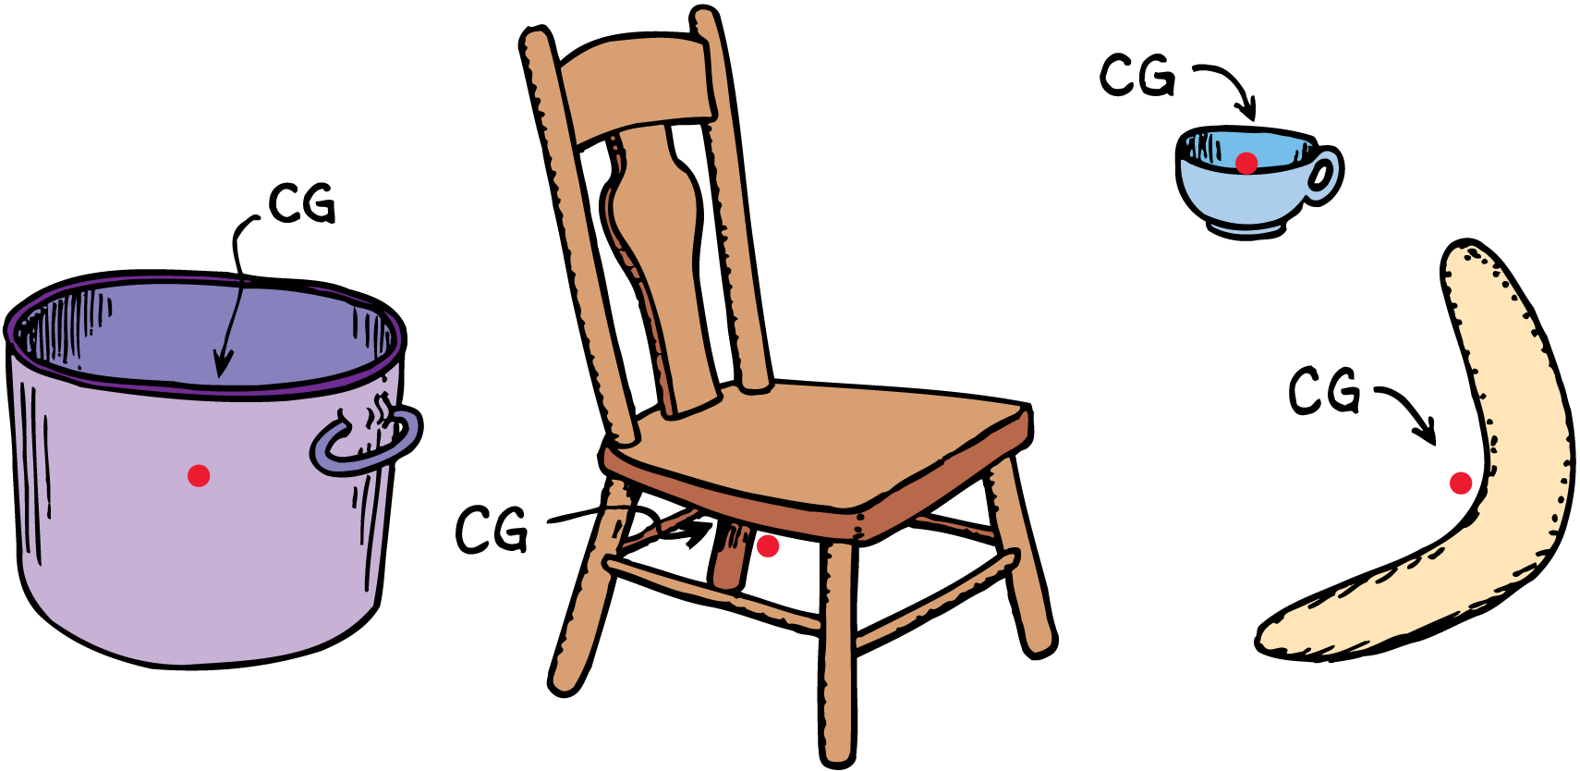
Centre of Mass and Gravity
There is no material at the CG of these objects.

Slide 10
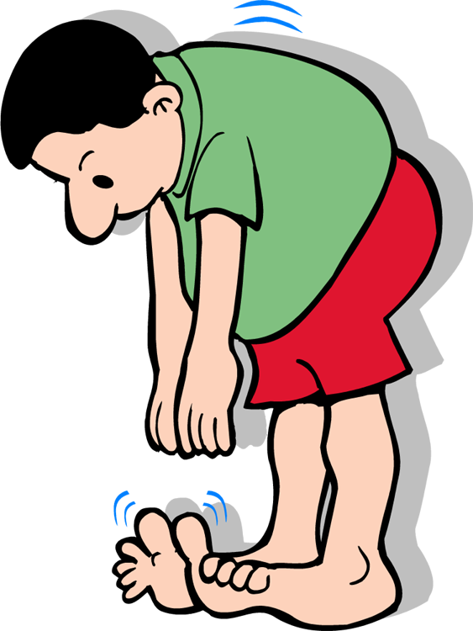
Stability
Challenge 1 - Can you touch your toes?
Challenge 2 - Now …. Can you touch your toes with your heels and bottom up against a door?

Slide 11
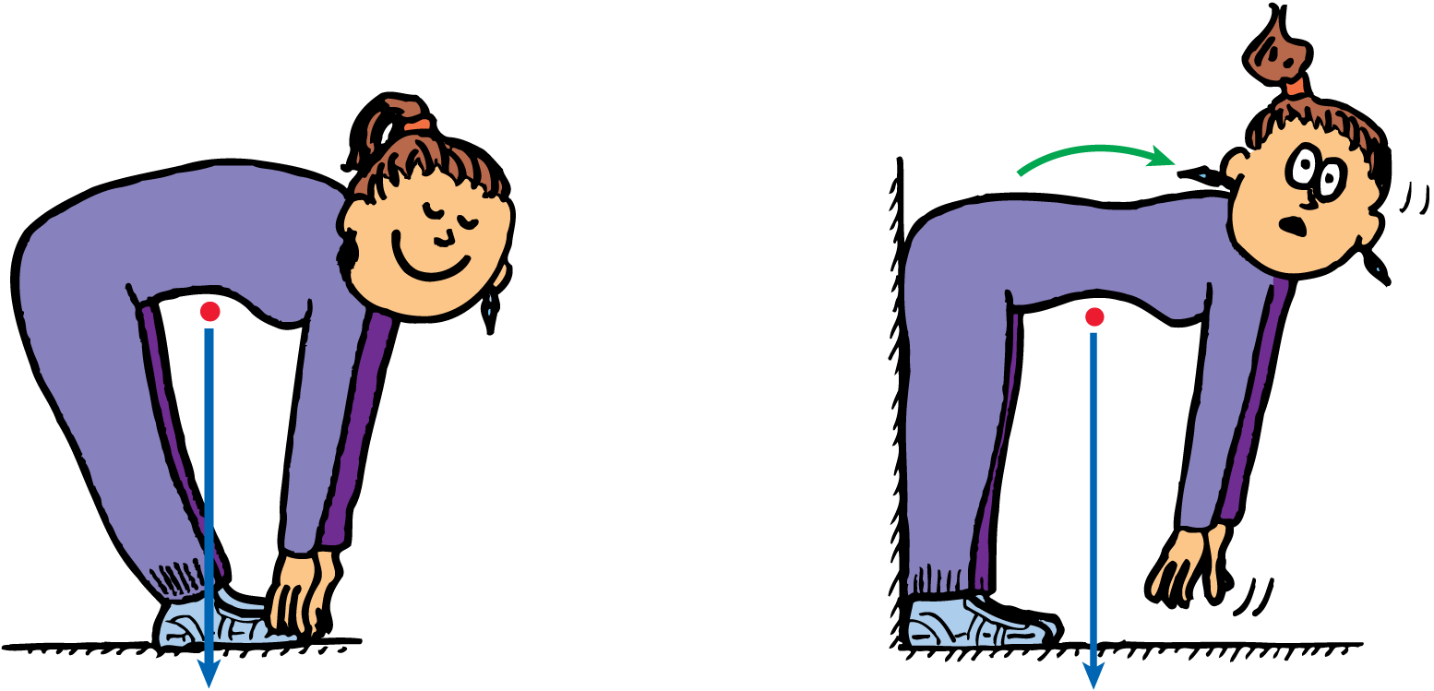
You can lean over and touch your toes without toppling only if your CG is above the area bounded by your feet.
When you lean forward your C of G moves and unless part of you goes backwards at the same time, the line of force will cause Torque about your toes!

Slide 12
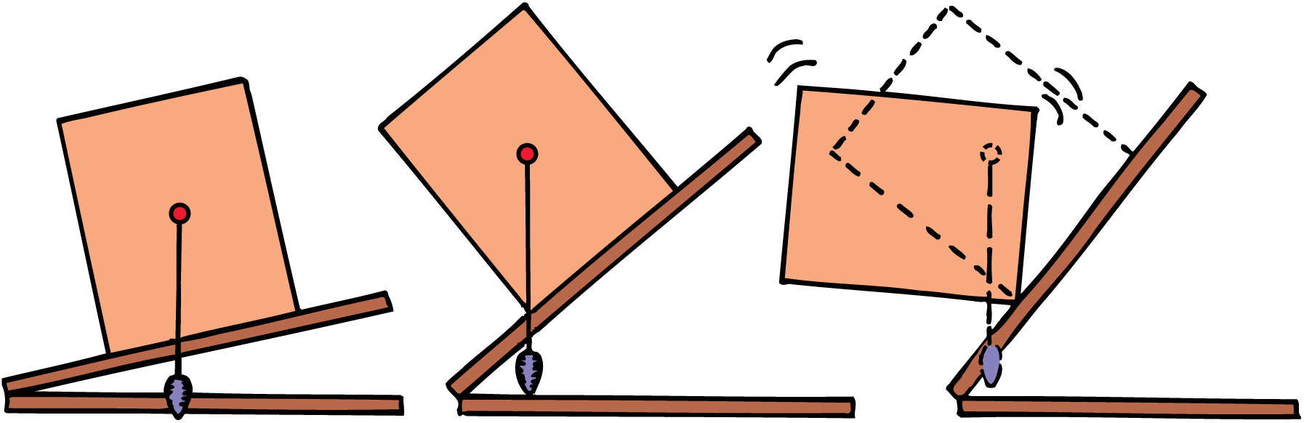
Stability
Definition:
Stability refers to the ability of an object to return to its original position after it has been tilted slightly.
The block topples when the CG extends beyond its support base.

Slide 13
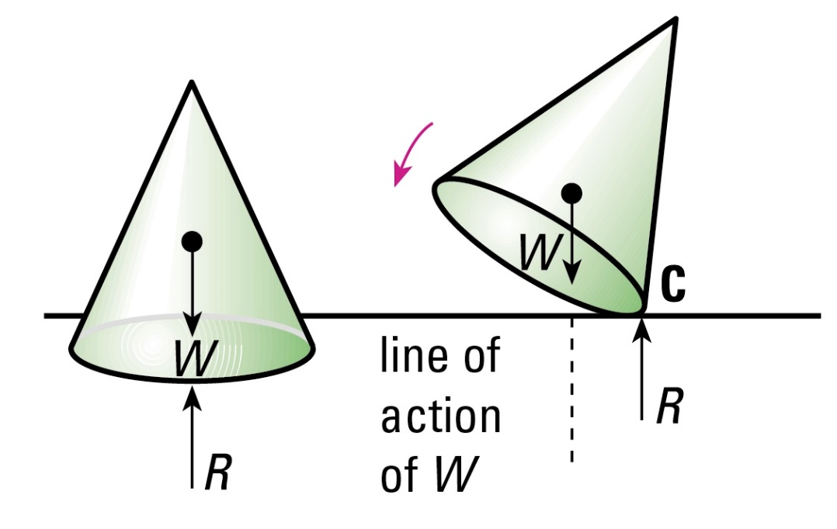
Stable Equilibrium
A small movement will cause…
The centre of gravity to rise and then falls back again.
The line of action of its weight W lies inside the base area of the cone.
The anticlockwise moment of its weight W about the point of contact C cause the cone to return to its original position. (We call this stabilizing torque)
Stable Equilibrium.

Slide 14
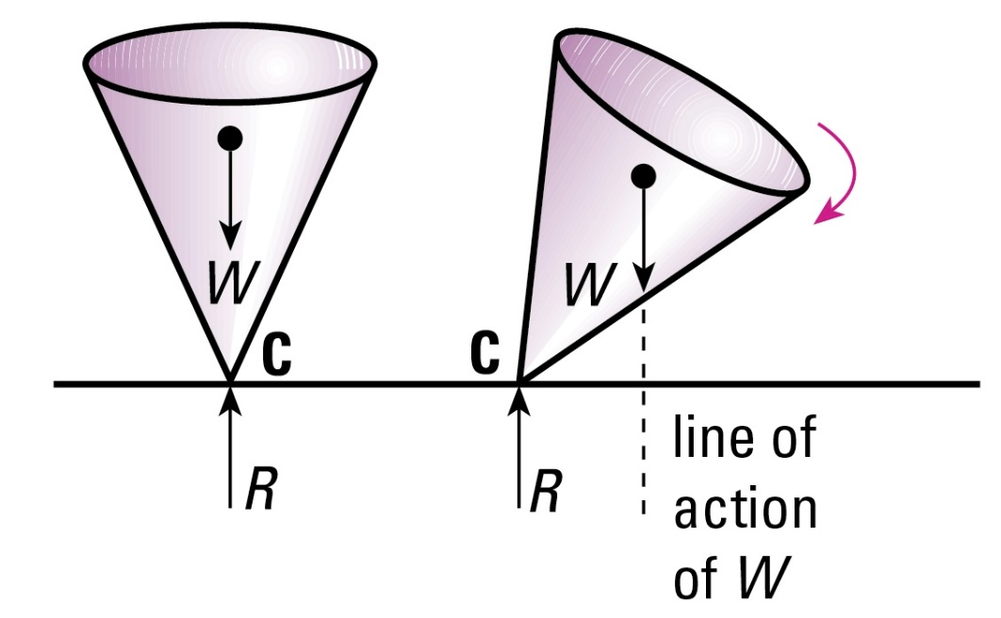
Unstable Equilibrium
A small movement will cause…
The centre of gravity to drop and continues to fall further.
The line of action of its weight W lies outside the base area of the cone.
The clockwise moment of its weight W about the point of contact C causes the toppling. (We call this destabilizing torque)
Unstable Equilibrium.

Slide 15
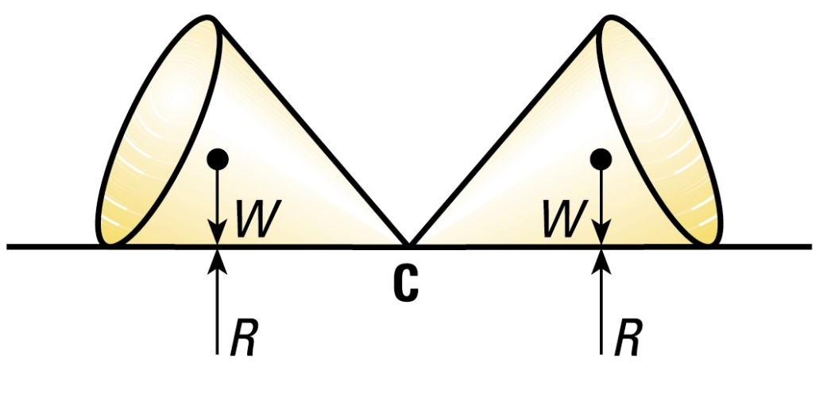
Neutral Equilibrium
A small movement will cause…
The centre of gravity to neither rise nor fall; it remains at the same level above the surface supporting it.
The lines of action of the forces remains directly above the pivot.
There is no moment provided but its weight W about the point of contact C to turn the paper cone.
Neutral Equilibrium.

Slide 16
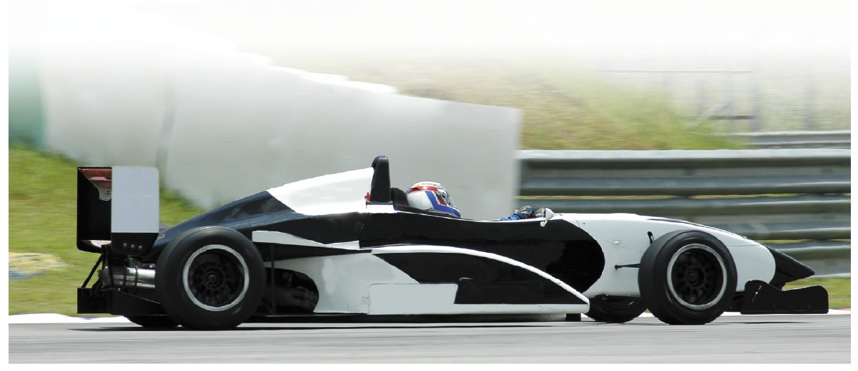
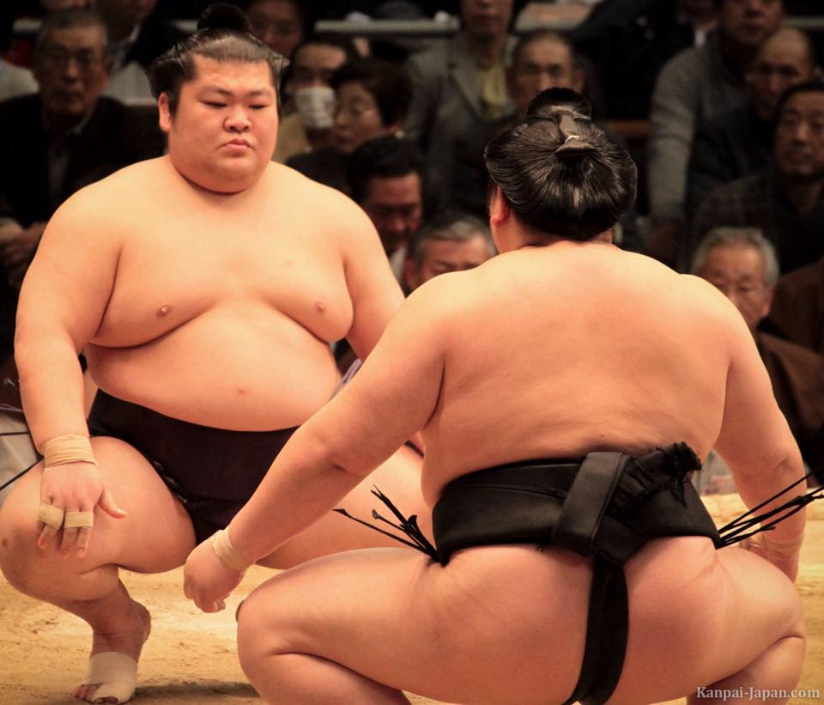
Stability
Sumo wrestlers try to keep their centre of gravity as low as possible, spreading their base of support wide to decrease the chances of being toppled over.
Hence, to increase stability of object, keep….
the Centre of gravity as low as possible.
the area of its base as wide as possible.
The more stable a car, the faster it can go round turns without overturning. Hence, all racing cars have a very low wide base and a low centre of gravity.

Slide 17
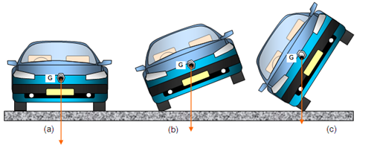
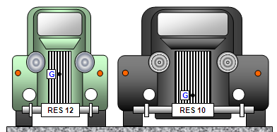
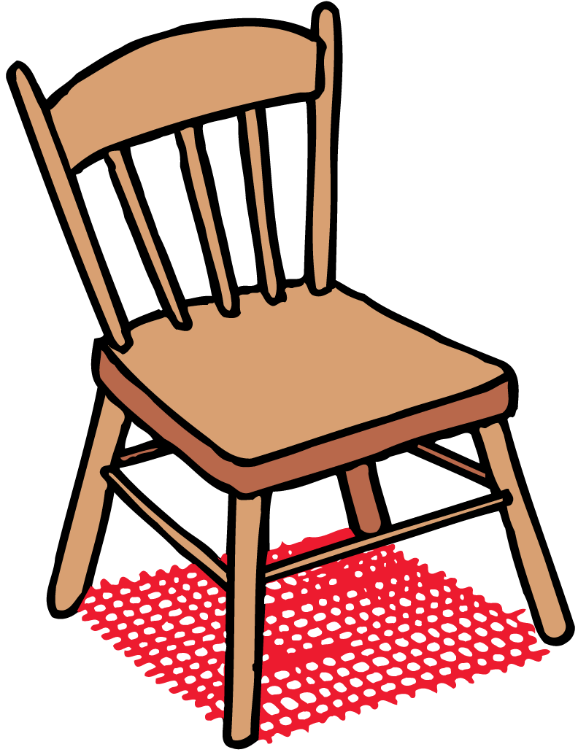
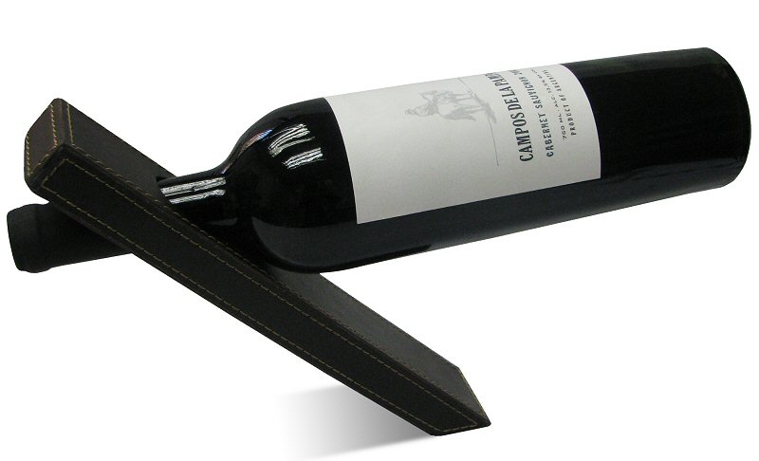
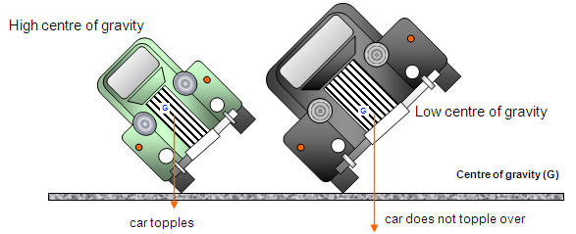
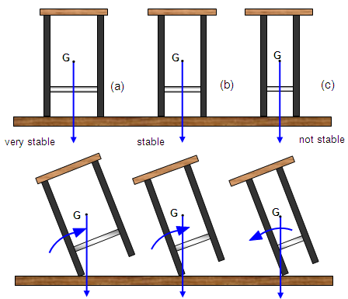
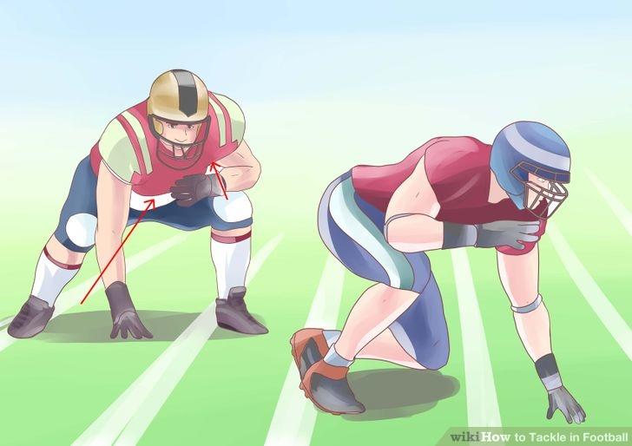
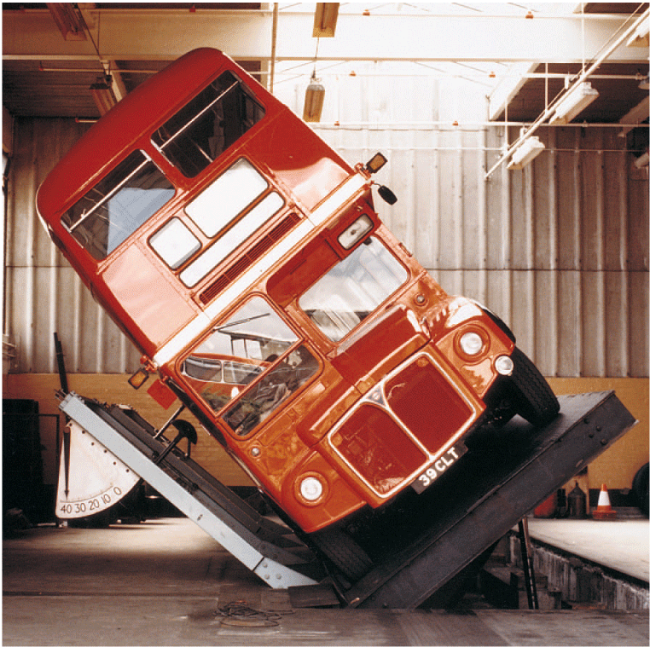
Examples

Slide 18
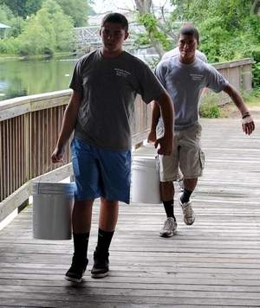
Stability of People
think!
When you carry a heavy load—such as a bucket of water with one arm……….
Why do you tend to hold your free arm out horizontally?

Slide 19
Stability of People
think!
When you carry a heavy load—such as a bucket of water with one arm……….
Why do you tend to hold your free arm out horizontally?
Answer:
You tend to hold your free arm outstretched to shift the CG of your body away from the load so your combined CG will more easily be above the base of support. To really help matters, divide the load in two if possible, and carry half in each hand. Or, carry the load on your head!

Slide 20
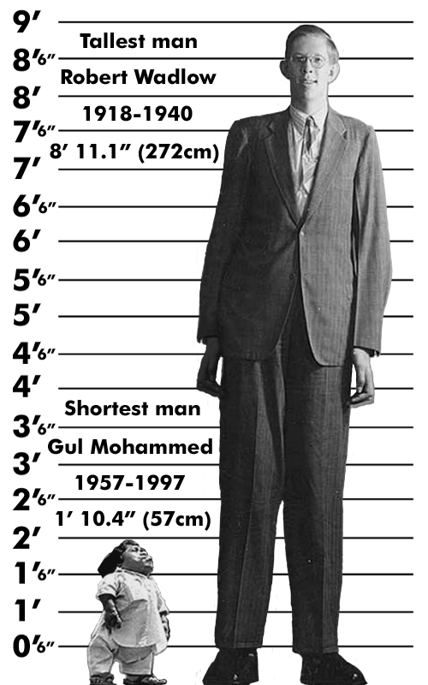
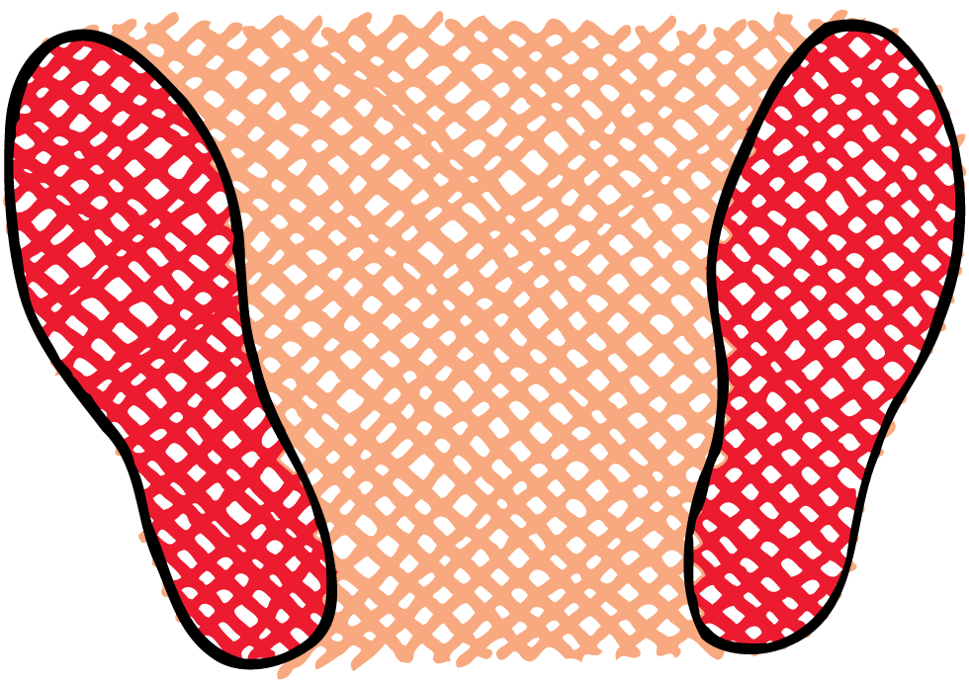
Stability of People
think!
Why do tall people have bigger feet?

Slide 21
Stability of People
think!
Why do tall people have bigger feet?
Answer:
Tall people have higher C of G’s and therefore a small angle of movement would cause the line of weight force to move outside their feet if they were not larger.

Slide 22
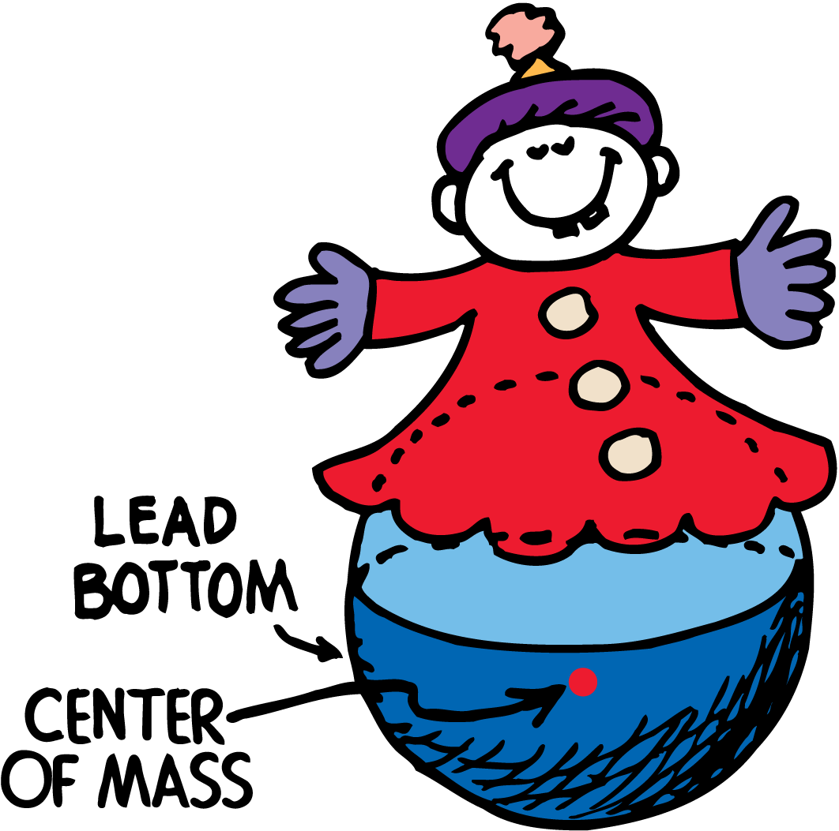
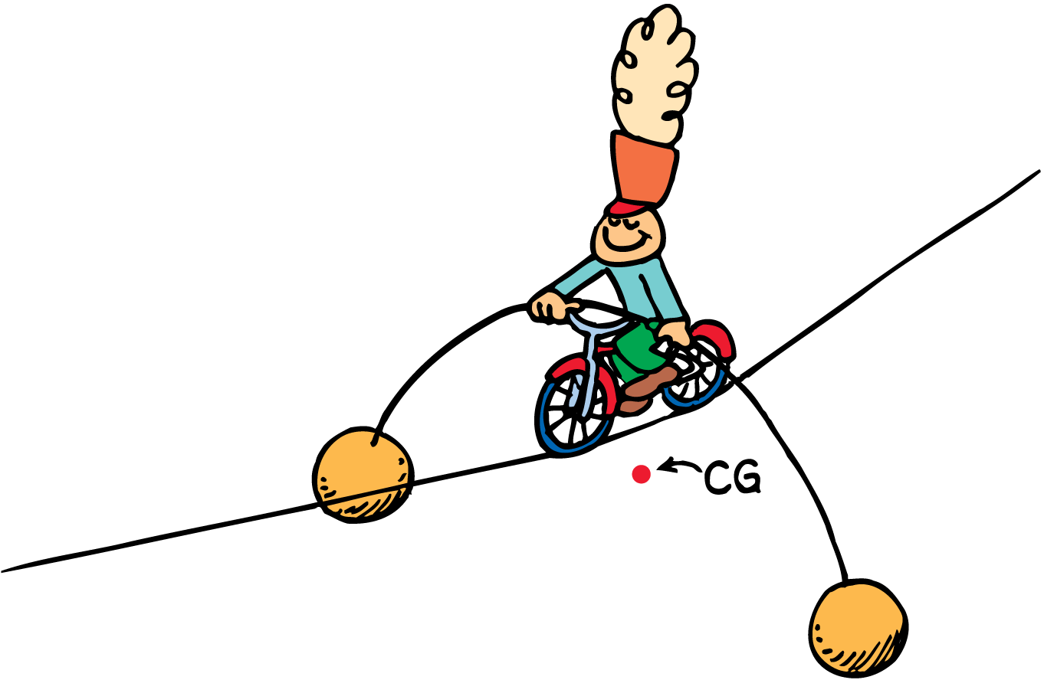
Stability of Toys
Why are these toys so stable?
The toys are in stable equilibrium because the CG rises when the toys tilt which causes stabilizing torque.

Slide 23
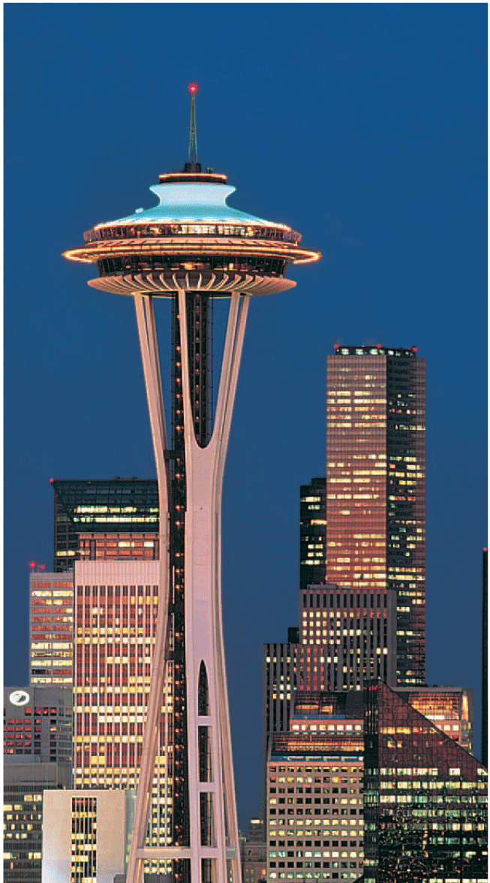
Stability of Buildings
The Seattle Space Needle is so “deeply rooted” that its center of mass is actually below ground level.
It cannot fall over intact because falling would not lower its CG at all. If the structure were to tilt intact onto the ground, its CG would be raised!

Slide 24
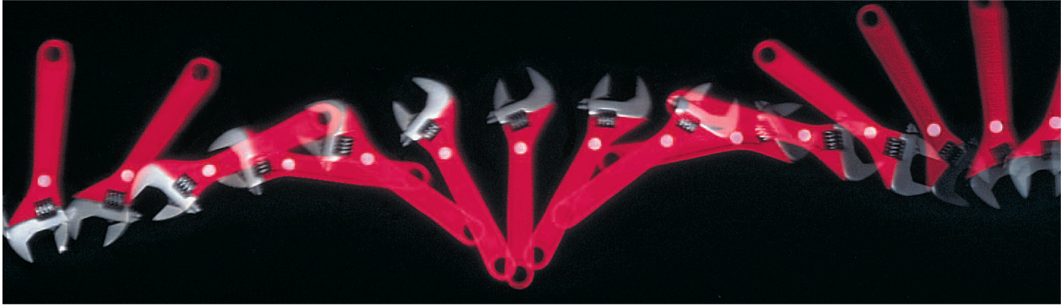
Center of Mass and Motion
When we describe motion, it is the centre of mass that follows the path described. E.g. for projectile motion or high jumpers.
The centre of mass of the rotating wrench follows a straight-line path as it slides across a smooth surface.

Slide 25
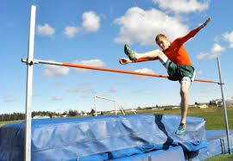
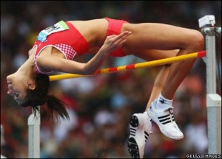
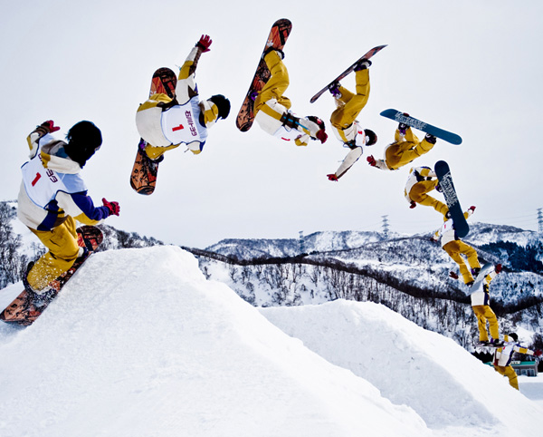
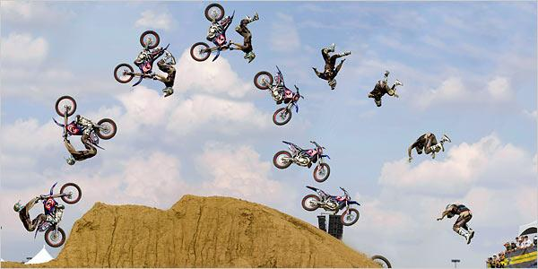
Center of Mass and Motion

